Slide 1
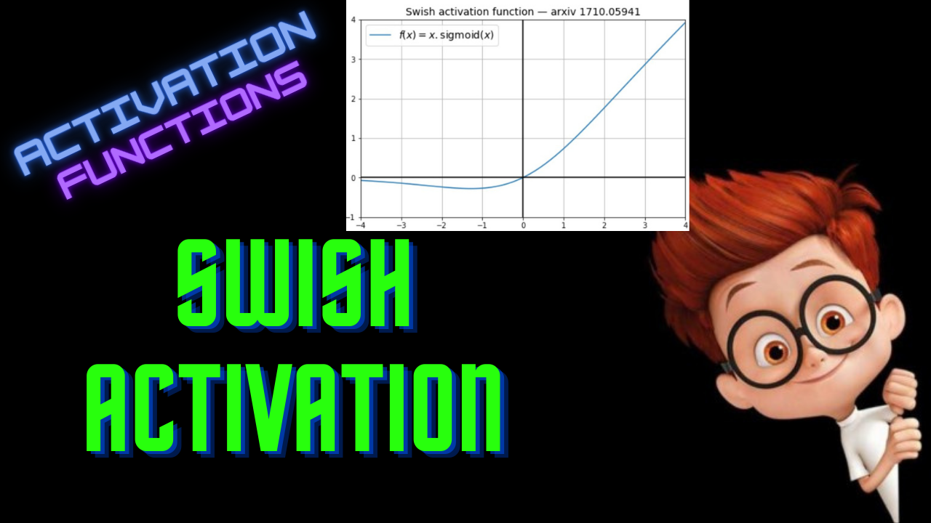

Slide 2
Swish Activation
ML For Nerds

Slide 3
Neural Architecture Search (NAS)

Slide 4
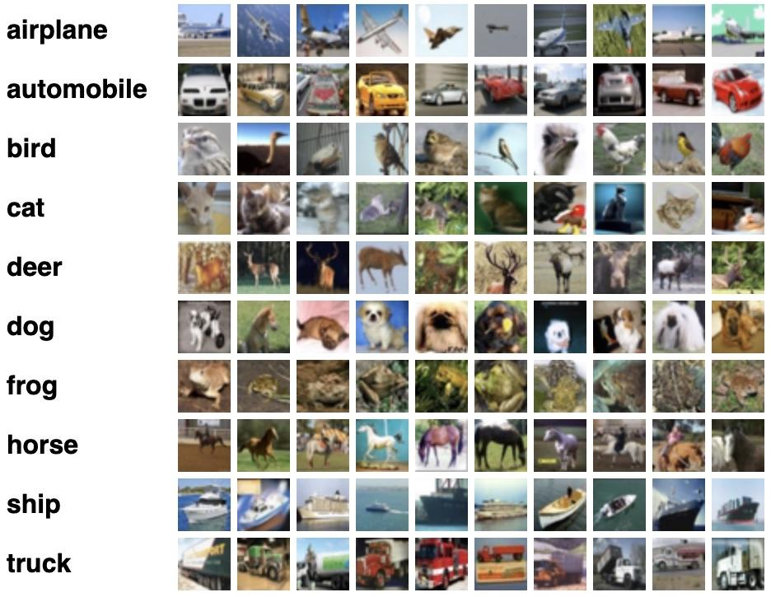
Image Classifier

Slide 5
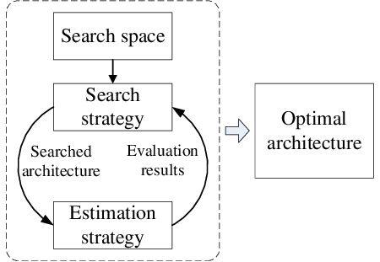
Neural Architecture Search

Slide 6
Automated Search for Activation Functions

Slide 7
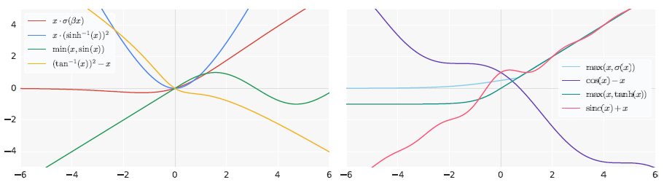
Discovered Activations

Slide 8
Evaluated on
Datasets:
CIFAR-10
CIFAR-100
Networks:
ResNet (RN)
Wide ResNet (WRN)
DenseNet (DN)
Activation:
ReLU

Slide 9
Evaluated on
Datasets:
CIFAR-10
CIFAR-100
Networks:
ResNet (RN)
Wide ResNet (WRN)
DenseNet (DN)
Activation:
ReLU

Slide 10
Evaluated on
Datasets:
CIFAR-10
CIFAR-100
Networks:
ResNet (RN)
Wide ResNet (WRN)
DenseNet (DN)
Activation:
ReLU

Slide 11
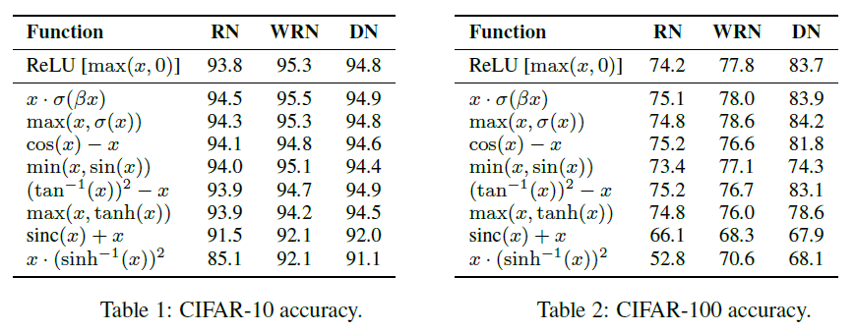
Evaluation Results

Slide 12
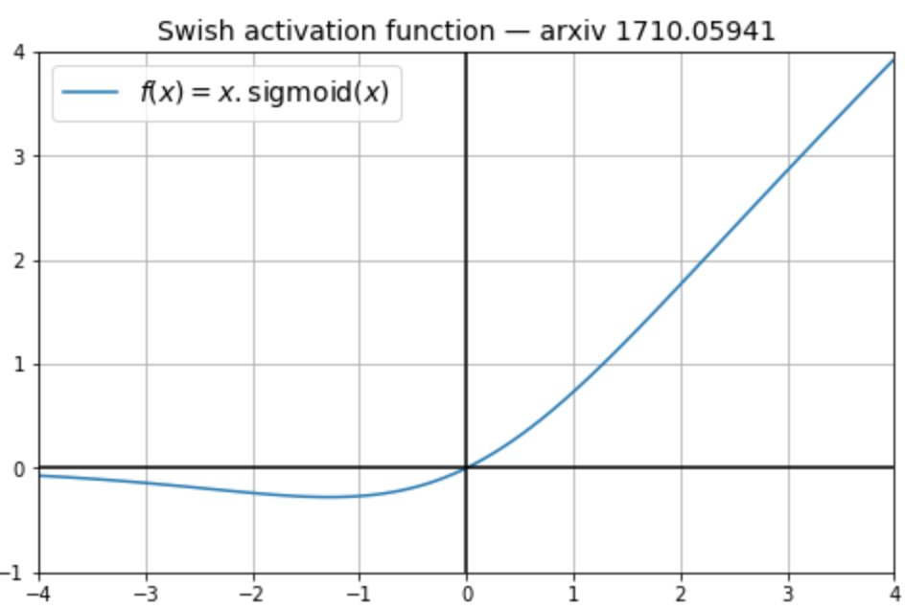
Swish Activation

Slide 13
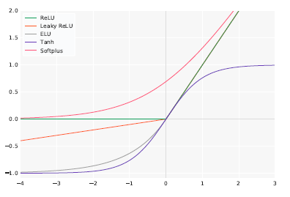

Slide 14
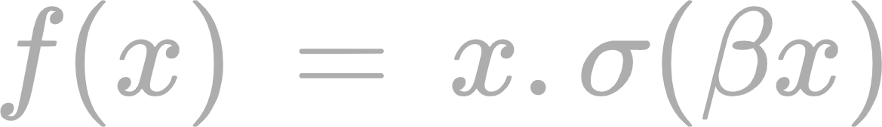

General Form
Is a constant or trainable parameter

Slide 15
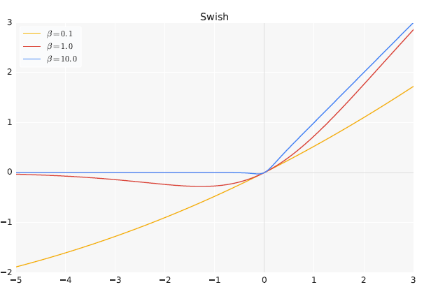

Slide 16


Derivative

Slide 17
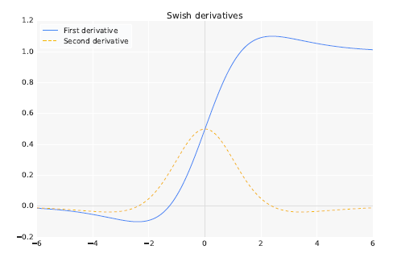
Derivatives

Slide 18
Properties of Swish
Unboundedness
Non-monotonic
Smoothness

Slide 19
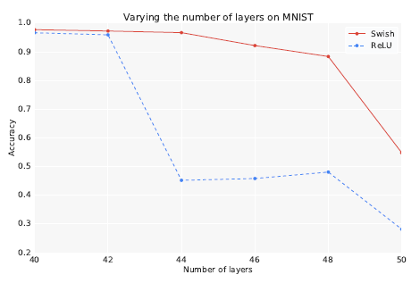
Swish Vs ReLU

Slide 20
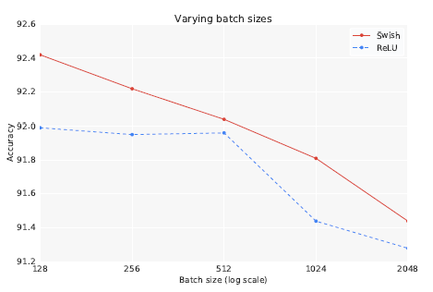
Swish Vs ReLU

Slide 21
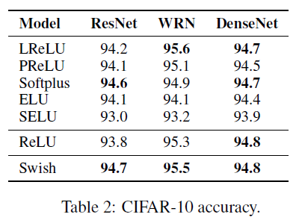
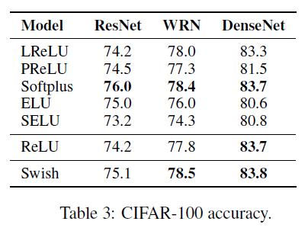
Image Classification

Slide 22
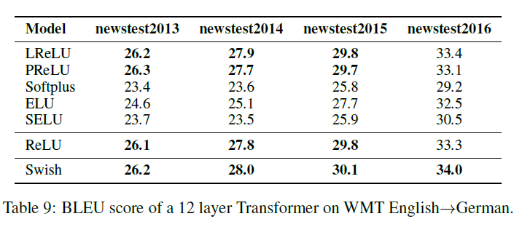
Machine Translation

Slide 23
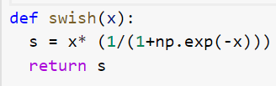
Python Implementation

